Slide 1

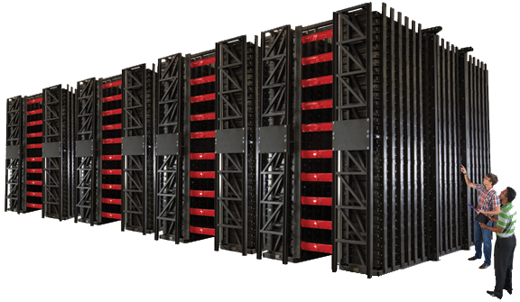
Dynamic Power Resource™
New England Electricity Restructuring Roundtable
April 15, 2011
Version 10

Slide 2
Xtreme Power, Inc.
Who we are…
Developer and manufacturer of Dynamic Power Resources™
  Founded in 2004 in Kyle, Texas
  20+ years of R&D in our technology
  Contracts awarded and in final negotiations > 60 MWh
  US-based manufacturing
    Oklahoma and Texas
    200 MWh of capacity
    Expansion option: > 1 GWh
  Over $50 MM in funding: SAIL VP, Bessemer VP, Dow Chemical, Fluor, Dominion Power, BP, POSCO, Skylake Incuvest
  Utility industry leadership on our Board – Pat Wood, Foster Duncan

Slide 3
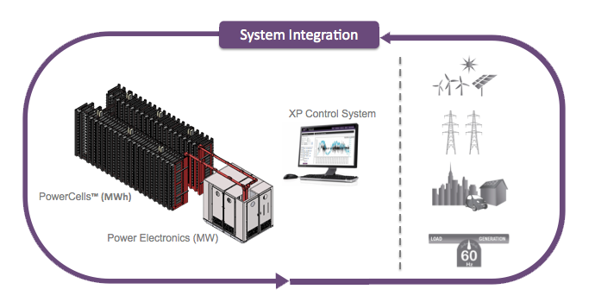
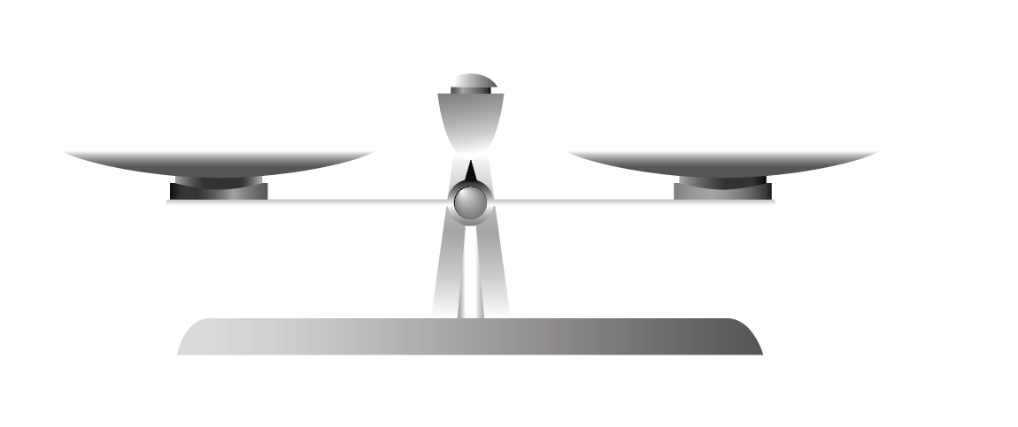
Xtreme Power Technology
Our Product
System Integration
Communication with existing/planned assets
Meets or exceeds national Cyber Security standards
Balance of Systems experience, including turn-key services
Modular approach allows scaling without compromising reliability
Notes:
Jenna

Slide 4
Real Projects, Real Solutions
Project | Application | DPR™ | COD | Services
SPT | Ancillary Services | 0.5 MW / 0.1 MWh | Q4 2006 | Peak-Shaving, Load-leveling
Maui | Wind | 1.5 MW / 1.0 MWh | Q3 2009 | Ramp Control, Curtailment Mitigation
Kahuku | Wind | 15 MW / 10 MWh | Q1 2011 | Ramp Control, Curtailment Mitigation
Xcel | Solar | 1.5 MW / 1.0 MWh | Q1 2011 | Ramp Control, Curtailment Mitigation, Grid Services
Lanai | Solar | 1.125 MW / 0.5 MWh | Q2 2011 | Ramp Control, Grid Services
Ford | End-User | 0.75 MW / 2.0 MWh | Q2 2011 | Peak-Shaving, Load-leveling
KIUC | Solar | 1.5 MW / 1.0 MWh | Q3 2011 | Ramp Control, Grid Services
KWP II | Wind | 10 MW / 20 MWh | Q4 2011 | Ramp Control, Responsive Reserves, Grid Services
Fosters* | End-User | 3.0 MW/ 2.0 MWh | Q4 2011 | Uninterruptible Power Source
Tumbleweed* | Wind | 36 MW / 24 MWh | Q4 2012 | Responsive Reserves, Regulation Services, Grid Services
Tres Amigas | T&D | ~ 100 MW / 200 MWh | Q2 2013 | Backup Services, A/S, Wind Firming & Shaping, Grid Services
* Project not yet announced publicly

Slide 5

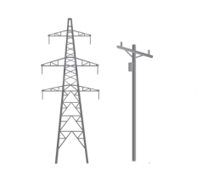


Target Segments
Renewable Developers & Owners
Ancillary Service Providers
Frequency Regulation
Transmission & Distribution Providers
Curtailment Mitigation
Firming/Shaping
Interconnection Compliance
Grid Services
End Users
$ B
Voltage Support
Power Quality
Grid Reliability Enhancement
Voltage Regulation
Responsive Reserves
Peak Shaving
Load Leveling
Power Quality
T&D Deferral
Ramp Control

Slide 6


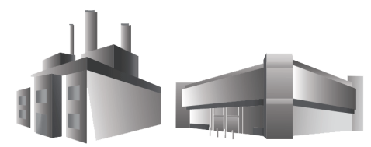
Redundant Transmission
100 MW
Capacity: 200 MW
100 MW
Capacity: 200 MW
100 MW
Capacity: 200 MW
100 MW
Capacity: 200 MW
Generator A
Generator B
Load Center: 400 MW
Business As Usual

Slide 7
Loss of Line: N-1 Transmission
200 MW
Capacity: 200 MW
100 MW
Capacity: 200 MW
100 MW
Capacity: 200 MW
Generator A
Generator B
Load Center: 400 MW
With one transmission line interrupted, second line serves load.

Slide 8
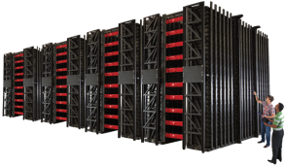
Loss of Line: Storage Engages
150 MW
Capacity: 200 MW
100 MW
Capacity: 200 MW
100 MW
Capacity: 200 MW
Generator A
50 MW
Capacity: 50 MW
Generator B
Load Center: 400 MW
The supply flowing on interrupted transmission line now comes from storage. Storage runs until system stabilizes.

Slide 9
Prepared for N-1-1 Need
Load Center: 450 MW
200 MW
Capacity: 200 MW
113 MW
Capacity: 200 MW
113 MW
Capacity: 200 MW
Generator A
Off-line
Capacity: 50 MW
Generator B
Generator C
50 MW
With time provided by Storage, urban generator comes online to prepare for next contingency. Storage will need to recharge.

Slide 10

Thank You
Mike Jacobs
Regulatory and Market Policy
mjacobs@xtremepower.com
111 Congress, Suite 700
Austin, TX 78701
202-406-0774

Slide 11
Modeling for More Dense Areas
Applications for grid support
Upgrade example: Reliability need for N-1-1
Replace power plant, run only for reliability
After model results, rules must be examined
Uncertainties in rules determine utility
adoption of such solutions
Reliability Criteria met with first iteration
of 20 MW fast acting storage

Slide 12
Preliminary Results
Problem:
Transmission fixes are “lumpy”- next increment of fix is very large
138 KV network inadequate to meet N-1-1, so rebuild to 230 KV proposed. Cost for rebuild $275 – 300 MM
Solution:
Upgrades with 20 MW Storage (footprint 13,000 sq ft)
Range of Cost: $50 - $80 MM depending on duration of discharge

Slide 13
BAU Transmission
100 MW
Capacity: 200 MW
100 MW
Capacity: 200 MW
100 MW
Capacity: 200 MW
100 MW
Capacity: 200 MW
Generator A
Generator B
Load Center: 400 MW
Business As Usual

Slide 14
Loss of Line: N-1 Transmission
200 MW
Capacity: 200 MW
100 MW
Capacity: 200 MW
100 MW
Capacity: 200 MW
Generator A
Generator B
Load Center: 400 MW
With one transmission line interrupted, second line serves load.

Slide 15
Loss of Line: Storage Engages
150 MW
Capacity: 200 MW
100 MW
Capacity: 200 MW
100 MW
Capacity: 200 MW
Generator A
50 MW
Capacity: 50 MW
Generator B
Load Center: 400 MW
The supply flowing on interrupted transmission line now comes from storage. Storage runs until system stabilizes.

Slide 16
Prepared for N-1-1 Need
Load Center: 450 MW
200 MW
Capacity: 200 MW
113 MW
Capacity: 200 MW
113 MW
Capacity: 200 MW
Generator A
Off-line
Capacity: 50 MW
Generator B
Generator C
50 MW
With time provided by Storage, urban generator comes online to prepare for next contingency. Storage will need to recharge.

Slide 17
BAU Transmission: Load Growth
83 MW
Capacity: 200 MW
125 MW
Capacity: 300 MW
83 MW
Capacity: 200 MW
125 MW
Capacity: 300 MW
83 MW
Capacity: 200 MW
Generator A
Generator B
Load Center: 450 MW
Load grows by 50 MW. Traditional solution is to either add another line (shown on left) or increase current line capacity with lumpy additions (shown on right, red lines). Expensive and long installation time.

Slide 18
Storage Defers Upgrades
113 MW
Capacity: 200 MW
113 MW
Capacity: 200 MW
113 MW
Capacity: 200 MW
113 MW
Capacity: 200 MW
Generator A
0 MW
Capacity: 50 MW
Generator B
Load Center: 450 MW
Clean, less-expensive, perfectly sized energy storage is placed in urban setting within months to meet load growth and N-1 requirement. This defers traditional upgrades, offers a fast solution and saves rate-payers money.

Slide 19
Out of Merit Generation?
Urban generator off-line until transmission interruption
Storage supplies power until urban generator at full, efficient level of output
Storage sized depending on characteristics (i.e. start-time) of urban generator

Slide 20
N-1 Capacity w/o OOM urban gen
Load Center: 450 MW
200 MW
Capacity: 200 MW
113 MW
Capacity: 200 MW
113 MW
Capacity: 200 MW
Generator A
24 MW
Capacity: 50 MW
Generator B
Generator C
Coming on-line
Capacity: 75 MW
Line drops and storage provides additional capacity. Urban generator was not started until contingency.

Slide 21
Prepared for N-1-1 Need
Load Center: 450 MW
200 MW
Capacity: 200 MW
113 MW
Capacity: 200 MW
113 MW
Capacity: 200 MW
Generator A
Off-line
Capacity: 50 MW
Generator B
Generator C
50 MW
With time provided by Storage, urban generator comes online to prepare for next contingency. Storage will need to recharge.

Slide 22
Satisfy N-1-1
Load Center: 450 MW
200 MW
Capacity: 200 MW
200 MW
Capacity: 200 MW
Generator A
Off-line
Capacity: 50 MW
Generator B
Generator C
50 MW
Capacity: 75 MW
With two lines out, still able to serve load continuously.

Slide 23
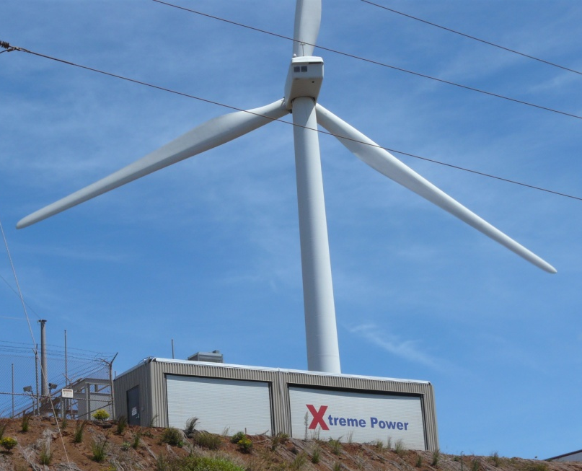
Real Projects, Real Successes
Kaheawa Wind Power
Location | Maui, Hi
Application | Wind
DPR™ | 1.5 MW / 1.0 MWh
COD | Q3 2009
Services | Ramp Control, Curtailment Mitigation
The first utility-scale Xtreme Power™ DPR™ operates on a 30 MW wind farm on a 80-200 MW grid. This DPR™ smoothes output to ±100kW/min and controls ramps to ±1MW/min.

Slide 24
Proof of Performance

Slide 25
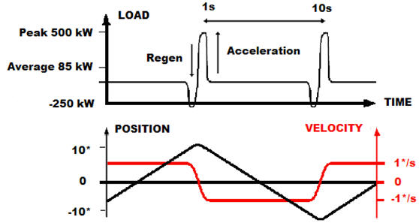
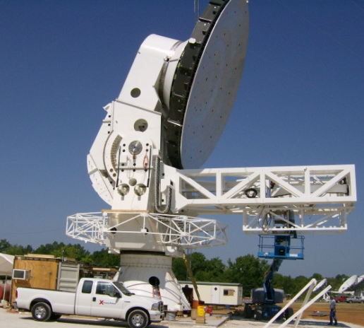
Real Projects, Real Successes
South Pole
Location | South Pole, Antarctica
Application | Ancillary Services
DPR™ | 0.5 MW / 0.1 MWh
COD | Q4 2006
Services | Peak-shaving, Load-leveling
In collaboration with several centers of higher education, the University of Chicago chose the Xtreme Power™ DPR™ to power the 200-ton South Pole Telescope’s scan cycles (illustrated above) without infringing on the station’s life support system. The Telescope requires up to 259,200 cycles/month.

Slide 26
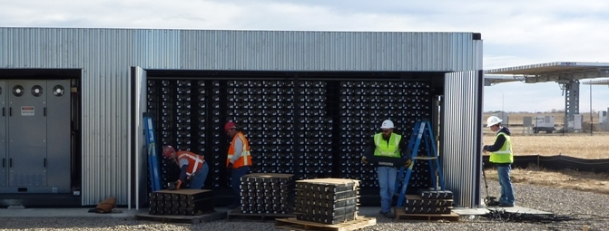
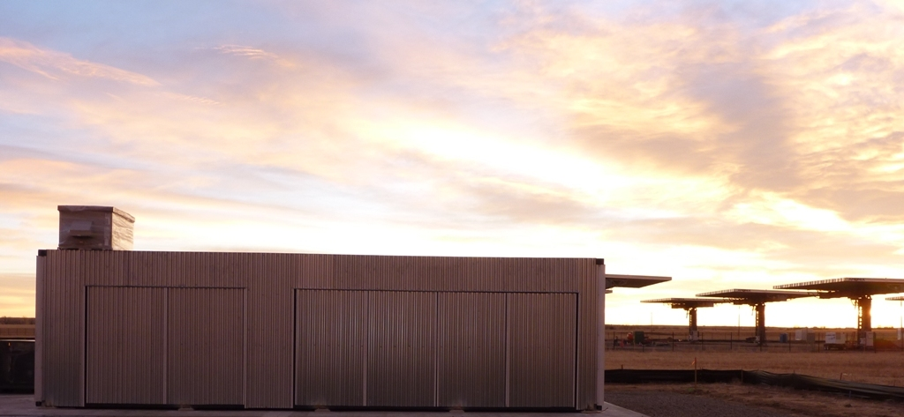

Real Projects, Real Successes
Xcel and SolarTAC
Location | Aurora, CO
Application | Solar
DPR™ | 1.5 MW / 1.0 MWh
COD | Q1 2011
Services | Ramp Control, Curtailment Mitigation, Grid Services
This system will collect operational data on the integration of energy storage and solar energy systems at the Solar Technology Acceleration Center.

Slide 27
Real Projects, Real Successes
Kaheawa Wind Power II
Location | Maui, HI
Application | Wind
DPR™ | 10 MW / 20 MWh
COD | Q4 2011
Services | Ramp Control, Curtailment Mitigation, Grid Services
This DPR™ will operate on a 21 MW wind farm on the island of Maui, and it will provide the Maui Electric Company (MECO) with responsive reserves, as well as for supporting services such as frequency and voltage regulation.

Slide 28
Zero min level Ancillary Services Example
Moving portions of A/S to a DPR eases Min Gen pressures
  CCGT with min level of 50 MW provides 25 MW Reg Up and 25 MW Reg Down
  DPR with min level of 0 MW provides 25 MW Reg Up and 25 MW Reg Down

Slide 29
Zero min level Ancillary Services Commercialization
XP to manufacture 10 MW/20 MWh DPR for variety of Renewable Integration Services in Hawaii
  DPR will operate on 21 MW wind farm on island of Maui to supply:
    Up to 10 MW Up Reserve and 8 MW Down Reserve
    Sophisticated droop response for frequency deviations beyond deadband
    Ramp Control to ±1MW/min
    AGC response capabilities
  Energy Storage creates value for IPP and Utility
    Reserves capability allows diesel gen offline thus reducing curtailment
    Expected to increase annual production of wind farm by ~70%
    Higher wind penetration and less generator A/S operation lead to lower variable costs on generators
    Estimated variable cost reduction of ~12.5%

Slide 30
Xtreme Power Technology
Our Product
System Integration
Communication with existing/planned assets
Meets or exceeds national Cyber Security standards
Balance of Systems experience, including turn-key services
Modular approach allows scaling without compromising reliability
Notes:
Jenna

Slide 31
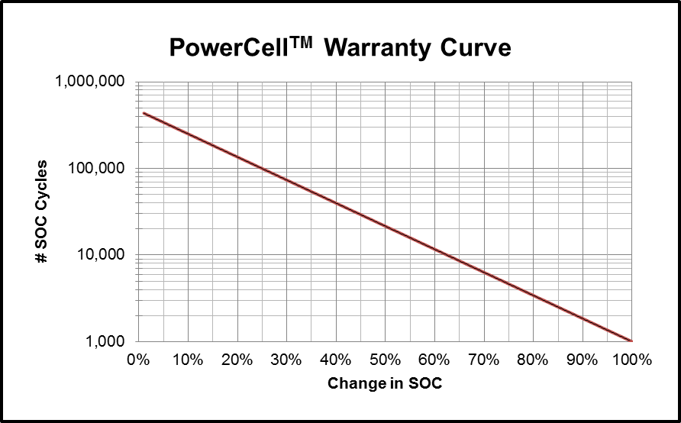
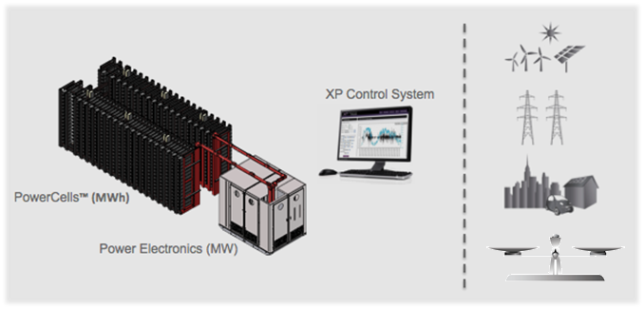
Xtreme Power Technology
Our Product
PowerCells™
  Solid-state, dry cell battery
  Uniform performance characteristics for scalability
  Low internal resistance
    Operates at ambient temperature
    Highly efficient
    High instant power capacity
  98% recyclable
  Safe, ease of siting
Notes:
Jenna

Slide 32
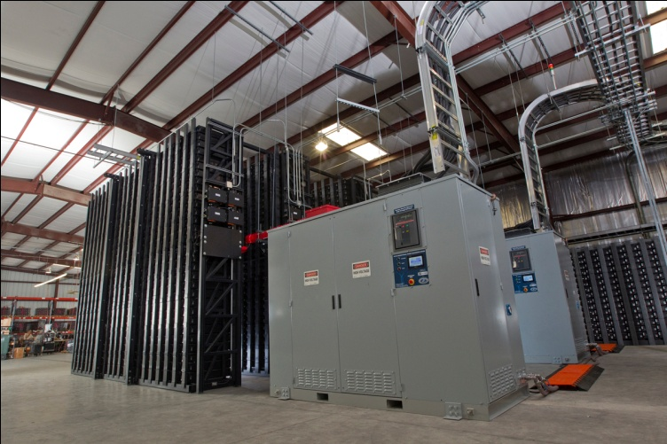
Xtreme Power Technology
Our Product
Power Electronics
Bi-directional inverter/charger technology
Full four quadrant performance, managing real & reactive power requirements
Solid State
  Microsecond response
  Nominal O&M
Close-Loop Water Cooled
Notes:
Jenna

Slide 33
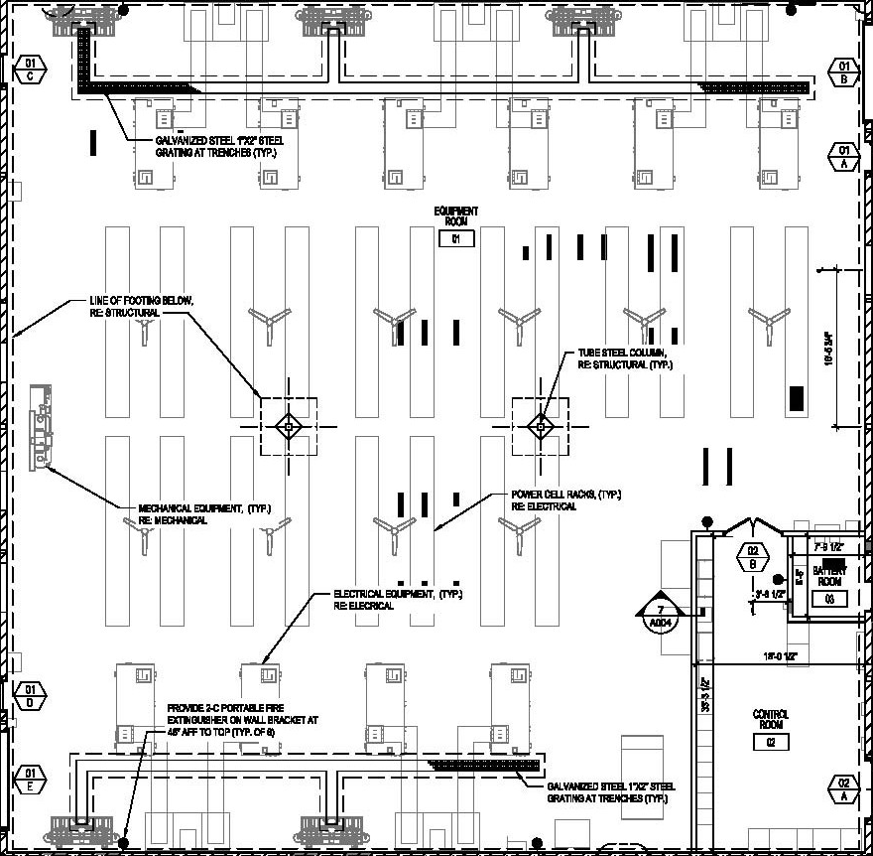
System Layout
93’
Layout of a
15 MW / 20 MWh DPR
(423 sq-ft/MWh)
91’
PowerCell™ Racks
Power Electronics

Slide 34
Production Capacity

